Slide 1
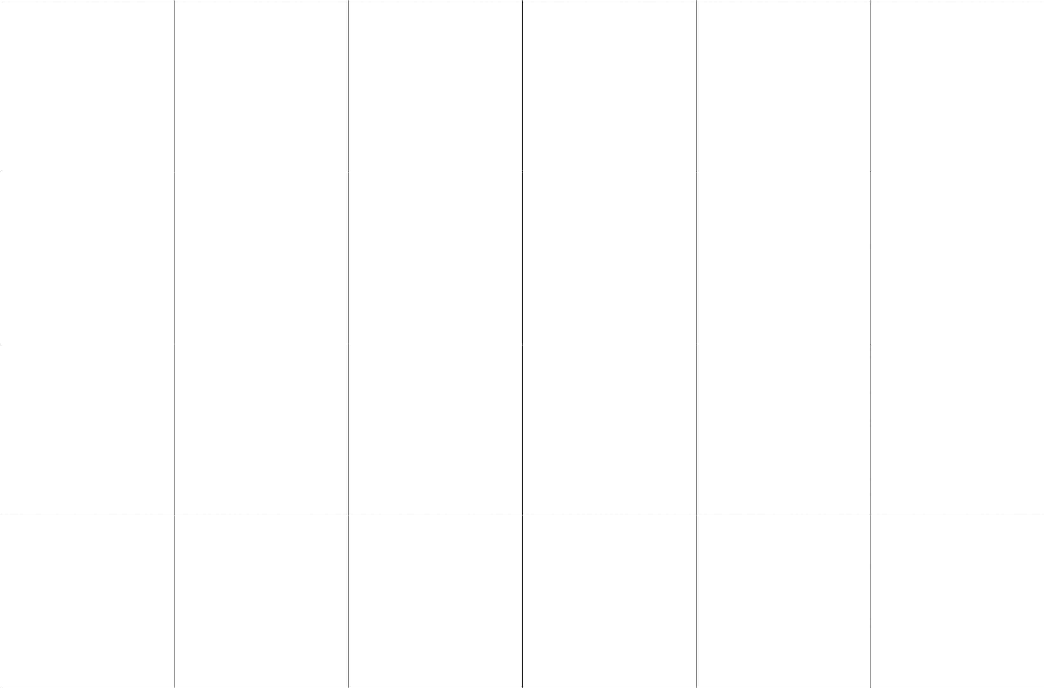
INTRODUCTION TO GRID
DI GGG YADA

Slide 2
TABLE OF CONTENT
01
04
What is grid
Important Definition
Fr Unit
Grid properties
Flexbox & Grid
Code along
02
05
03
06

Slide 3
01. WHAT IS GRID

Slide 4
WHAT IS GRID
CSS Grid, is a two-dimensional grid-based layout system
CSS Grid, ist ein zweidimensionales gitterbasiertes Layout-System

Slide 5
02. IMPORTANT DEFINITIONS

Slide 6

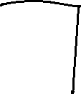




IMPORTANT DEFINITIONS
Grid Container
&
Grid Items
Aka Grid Parent
Aka Grid Children
<div class="container">
<div class="item1"> content </div>
<div class="item2"> content </div>
<div class="item3"> content </div>
</div>
Notes:
Parent
The element on which display: grid is applied. It’s the direct parent of all the grid items. In this example container is the grid container.
Children
The children (i.e. direct descendants) of the grid container. Here the item elements are grid items, but sub-item isn’t.

Slide 7










IMPORTANT DEFINITIONS
Grid Column
Aka Spalte

Slide 8


















IMPORTANT DEFINITIONS
Grid Row
Aka Zeile

Slide 9












IMPORTANT DEFINITIONS
Grid Area
Aka Bereich

Slide 10








































IMPORTANT DEFINITIONS
Fragen?

Slide 11
03. FR UNIT

Slide 12

FR UNIT
Fraction
responsive
portion of the remaining space
Notes:
PROZENT - Nicht umrechnen

Slide 13

FR UNIT
Fragen?
Notes:
PROZENT - Nicht umrechnen

Slide 14
04. GRID PROPERTIES

Slide 15
PARENT PROPERTIES
Display
.container 1 {
display: grid ;
}
.container 2 {
display: inline-grid;
}

Slide 16
PARENT PROPERTIES
Grid-template-columns
.container {
display: grid ;
grid-template-columns: ... ;
/*
25% 25% 25% 25%
1fr 1fr 1fr 1fr | repeat(4, 1fr)
250px repeat(number of column, column width)
*/
}

Slide 17


















PARENT PROPERTIES
Grid-template-row
.container {
display: grid ;
grid-template-columns: repeat(4, 1fr) ;
grid-template-rows: ... ;
/*
25% 25% 25% 25%
repeat(4, 1fr)
250px repeat(number of row, row height)
*/
}

Slide 18




PARENT PROPERTIES
(Grid-)column-gap
(Grid-)row-gap
.container {
display: grid ;
grid-template-columns: repeat(4, 1fr) ;
grid-template-rows: repeat(2, 1fr) ;
column-gap: 0;
row-gap: 0;
}

Slide 19



PARENT PROPERTIES
Grid-gap/Gap
.container {
display: grid ;
grid-template-columns: repeat(4, 1fr) ;
grid-template-rows: repeat(2, 1fr) ;
gap: 0;
/*
row-gap column-gap/ 10px 20px
*/
}

Slide 20
PARENT PROPERTIES
Fragen?
.container {
display: grid ;
grid-template-columns: repeat(4, 1fr) ;
grid-template-rows: repeat(2, 1fr) ;
gap: 0;
}

Slide 21
CHILD PROPERTIES
Grid-column-start/end
Grid-row-start/end
.item1 {
grid-column-start: 1;
grid-column-end: 5;
grid-row-start: 1;
grid-row-end: 2;
}

Slide 22
CHILD PROPERTIES
Grid-column
Grid-row
.item {
grid-column: 1 / 5;
grid-row: 1 / 2;
}

Slide 23
CHILD PROPERTIES
Grid-area
.item {
grid-area: row-start / column-start / row-end / column-end;
}

Slide 24






CHILD PROPERTIES
Overlapping Items
.item1 {
grid-area: 1 / 1 / 2 / 5;
}
.item2 {
grid-area: 1 / 1 / 3 / 3;
}

Slide 25






CHILD PROPERTIES
Fragen?
.item1 {
grid-area: 1 / 1 / 2 / 5;
}
.item2 {
grid-area: 1 / 1 / 3 / 3;
}

Slide 26
05. FLEXBOX & GRID

Slide 27
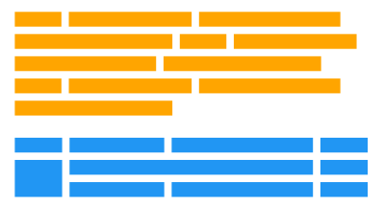
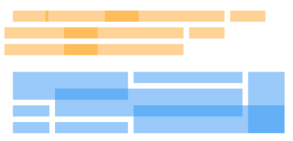
FLEXBOX & GRID
Grid is much newer than Flexbox and has a bit less browser support.
You can combine Grid and Flexbox. A Grid item can be a Flexbox container. A Flex item can be a grid container.
Flexbox is more... Flexible.
Grid is better at overlapping.

Slide 28
06. CODE ALONG

Slide 29
CODE ALONG
Testing
.item1 {
grid-area: 1 / 1 / 2 / 5;
background: rgba(242, 121, 53, .5);
}
.item2 {
grid-area: 1 / 1 / 3 / 3;
background: rgba(0, 255, 255, .5);
}

Slide 30
CODE ALONG
Aufgaben
Hilfreiche Links
https://cssgridgarden.com/#de
https://css-tricks.com/snippets/css/complete-guide-grid/
https://developer.mozilla.org/en-US/docs/Learn/CSS/CSS_layout/Grids
https://cssgrid-generator.netlify.app/

